Slide 1
Social Media Analysis
AISHIK DALUI

Slide 2
Project Overview
Analyzing social media engagement patterns
This project focuses on understanding user interactions and demographics through SQL insights, enabling effective identification of influencers and optimizing marketing strategies for better outreach.
7,488
8,782
257
Total Comments
Total Likes
Total Posts

Slide 3

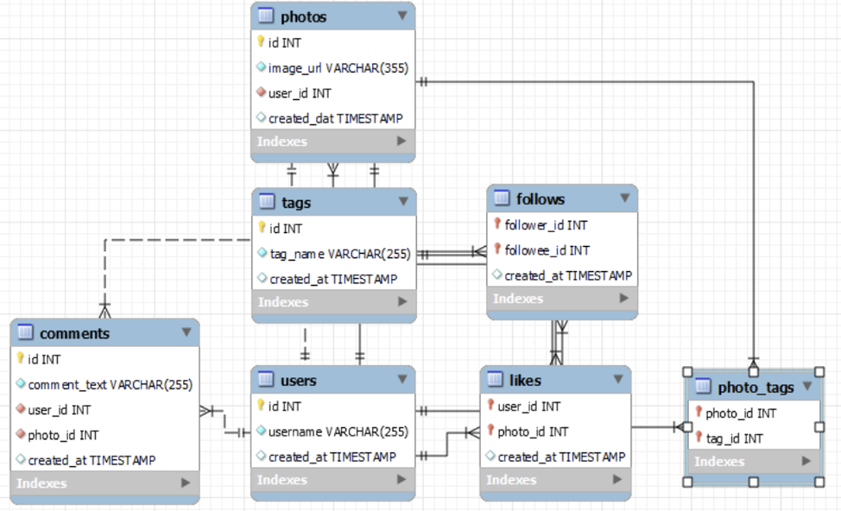
Database Schema
Users → user information (id, username, created_at)
Photos → images posted by users (id, image_url, user_id)
Likes → tracks photo likes (photo_id, user_id)
Comments → user comments on posts (photo_id, user_id, comment_text)
Tags → hashtags assigned to photos (photo_id, tag_name)
Relationships:
One user → many photos
One photo → many likes & comments
One photo → multiple tags

Slide 4
Data Overview
✓
~2
Avg Tags/Post
Dataset: Instagram clone database (ig_clone.sql)
Key Tables: users, photos, likes, comments, tagsTotal Users: 100 | Photos: 1000+ | Likes & Comments: Thousands
✓
No Null Values
No Duplicates
username & created_at: 0 nulls in users table
No user uploaded same photo twice (image_url + user_id)
1.95 tags per photo — moderate use of categorization
KEY INSIGHT Despite only 257 posts, the platform generates 8,782 likes and 7,488 comments — users are highly interactive consumers of content, not just passive viewers.

Slide 5
Objectives Key Metrics
User activity distribution (posts, likes, comments)
Identify top influencers and loyal users
Engagement by hashtag & posting time trends
Segmentation: Power Creators, Active, Dormant Users
Key metrics: CTR, Engagement Rate, Averege Likes per Post

Slide 6
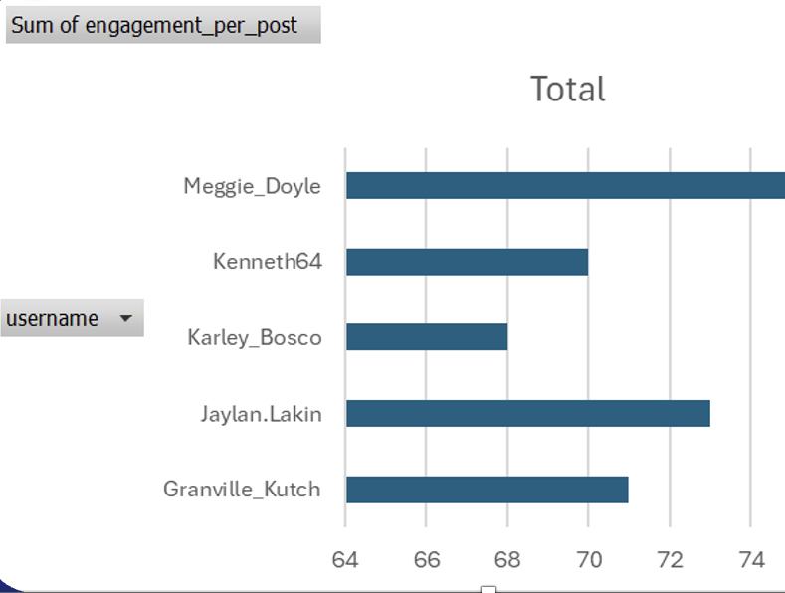
User Activity & Engagement Distribution
Meggie_Doyle has the highest engagement per post (75), making her the strongest performer.
Karley_Bosco has the lowest (68), while others like Jaylan.
Lakin (73) and Granville_Kutch (71) show solid engagement.

Slide 7
Engagement Behavior Segments
40–45% Zero Engagement Users Inactive or no posted content
~35% Mid-Level Engagers Consistent 60–66 interactions/post
~15% High Engagement 1–2 posts but strong quality
~10% Power Creators Drive majority of platform interactions
ACTION Nurture mid-level users (Alexandro35, Adelle96, Florence99) into top contributors. Users with 1–2 posts but high engagement are hidden gems — identify and activate them.

Slide 8
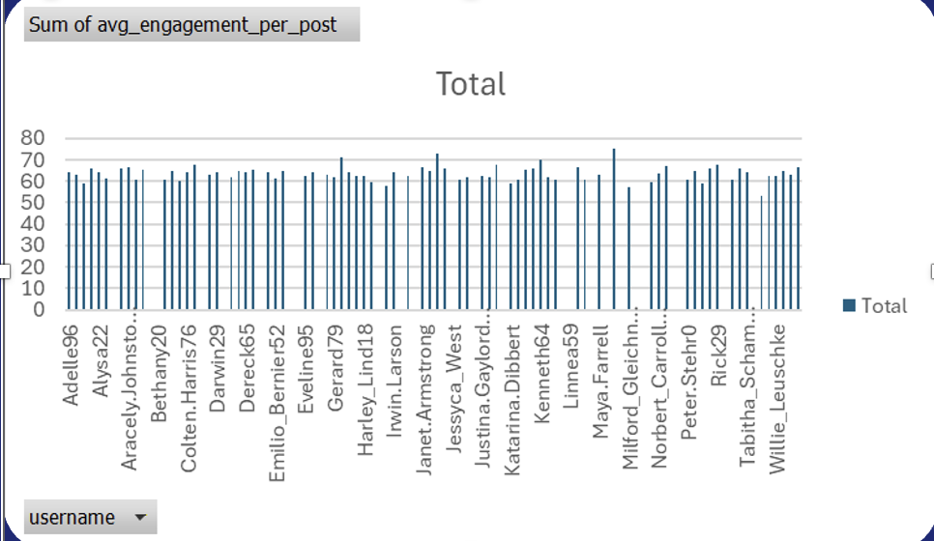
Per post average
Meggie_Doyle has the highest engagement.
Most users maintain a steady engagement around 60–66
Inactive users (with 0) bring down the total average.
Engagement is good overall, but not equally distributed among users.
The platform can encourage low-engagement users to be more active.

Slide 9
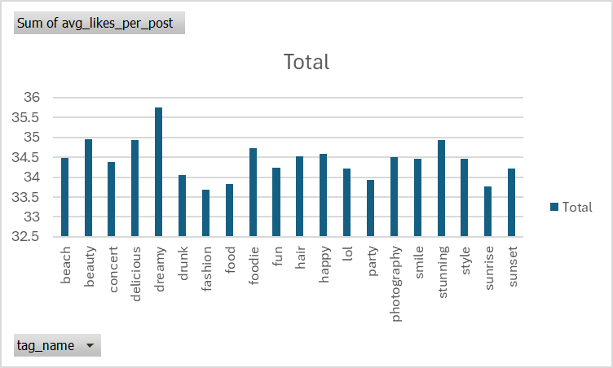
Avg Likes per tag
The total average likes across all hashtags is 688.6.
Most hashtags have average likes between 33 and 35, showing consistent engagement.
Top-performing hashtags with highest likes per post:
dreamy (35.75) — most liked posts.
beauty (34.95), stunning (34.94), and delicious (34.93) also perform very well.
Lowest performing hashtags:
fashion (33.68) and sunrise (33.76) — slightly
below average.

Slide 10
Hashtag Intelligence & Content Strategy
Top-performing hashtags driving ad targeting and content curation
Top Hashtags by Average Likes
Ad Campaign Alignment
#dreamy
#beauty
#stunning
#beauty / #hair
#delicious
Cosmetics & Salon brands
34.2 avg
35.75 avg likes
34.95 avg likes
34.94 avg likes
#foodie / #delicious
#foodie
#happy
#hair
Restaurants & Delivery apps
34.1 avg likes
33.9 avg likes
33.8 avg likes
#dreamy / #stunning
Travel & Lifestyle brands
#happy
Events & Entertainment
STRATEGY Visual appeal + positive emotion hashtags (#dreamy, #beauty, #happy) drive the highest avg likes. Align paid ad campaigns with these categories and build a hashtag suggestion tool for creators.

Slide 11
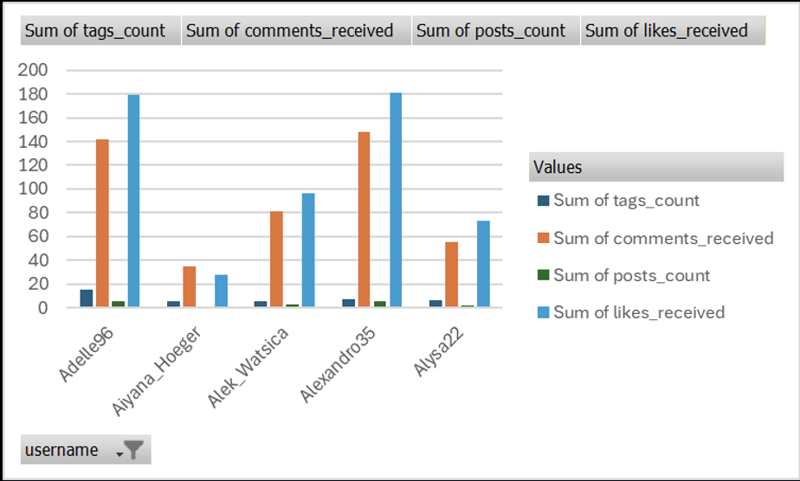
Top 5 users having highest likes, comments, and photo tags
Alexandro35 and Adelle96 are top-performing users.
More posts = more engagement.
Average engagement per post is moderate to good.
Users are actively liking and commenting on posts.
The platform shows positive engagement growth among active users.

Slide 12
User Segmentation & Targeted Campaigns
Four behavioral segments — four distinct marketing approaches
Power Creators
~10%
Active Engagers
~35%
Avg engagement >70/post
Avg engagement 40–70/post
e.g. Meggie_Doyle, Kenneth64, Rick29
e.g. Alexandro35, Adelle96, Florence99
Strategy: Creator Badge • Priority Feed Boost • Brand Collaborations • Early Feature Access
Strategy: Hashtag Challenges • Community Polls • Reward-based Participation Contests
Casual Users
~15%
Dormant Users
40–45%
Avg engagement 1–39/post
No posts or zero engagement
e.g. Mid-tier accounts
e.g. Aniya_Hackett, Kasandra_Homenick
Strategy: Personalized content tips • Trending hashtag suggestions • Posting reminders
Strategy: Comeback Creator Campaign • Re-activation Emails • Badge-based Incentives
BUSINESS IMPACT Engagement-based segmentation improves retention, optimizes marketing spend, strengthens creator ecosystems, and powers personalized recommendation algorithms.

Slide 13
Influencer & Brand Ambassador Identification
Data-driven criteria to select, tier, and collaborate with influencers
Top Influencer Candidates
Influencer Tier Strategy
1.
Meggie_Doyle
2.
Jaylan.Lakin
Potential Brand Ambassador
Criteria: ≥90 followers, ≥5 posts, avg eng ≥60
Use: Feature launches & platform-wide campaigns
3.
Granville_Kutch
4.
Kenneth64
Influencer Candidate
5.
Rick29
6.
Karley_Bosco
Criteria: ≥50 followers, ≥3 posts, avg eng ≥40
Use: Niche & regional promotions
High Engagement Creator
7.
Damon35
8.
Odessa2
Criteria: Avg engagement ≥50 per post
Use: Authentic reviews & UGC campaigns
9.
Janet.Armstrong
10.
Aracely.Johnston98
Community Advocate
Criteria: ≥3 posts, total engagement ≥100
Use: Hashtag challenges & beta testing
APPROACH Combine follower count (reach) with engagement rate (quality) to avoid vanity-metric traps. Micro-influencers with small but loyal audiences often outperform high-follower accounts in conversion.

Slide 14
Ad Campaign Optimization Framework
KPIs, funnel diagnostics, and budget reallocation strategy
CTR
CVR
CPC
CPA
ROAS
Clicks / Impressions × 100
Conversions / Clicks × 100
Cost / Clicks
Cost / Conversions
Revenue / Cost
Ad creative effectiveness
Landing page & offer quality
Efficiency of click acquisition
Cost per customer action
Return on ad investment
Funnel Diagnosis & Fix
Campaign Performance Example
!
Low CTR → Optimize creative, copy, targeting & CTA
Campaign
CTR
CVR
CPA
ROAS
Action
!
High CTR, Low CVR → Fix landing page, pricing & checkout UX
Campaign A
4.5%
8.2%
$12
5.8
Scale Up
Campaign B
6.0%
1.5%
$45
1.2
Fix LP
!
High CPA → Pause weak audiences, reallocate budget
Campaign C
1.0%
10%
$9
6.5
Boost CTR
!
Low ROAS → Retarget warm audiences, raise order value
OPTIMIZATION Shift budget to campaigns with ROAS >4. Use A/B testing on headlines and CTAs. Retarget click-but-no-convert users with personalized follow-up ads matched to their browsed hashtag categories.

Slide 15
Loyalty, Retention & Re-Engagement
Rewarding top creators and winning back dormant users
Most Loyal Users (by Total Engagement)
Reward & Incentive Program
Eveline95
♥ 420
💬 329
# 24
🏆
Top Creator Badge
Visible recognition on profile & feed
Clint27
♥ 361
💬 299
# 26
📈
Priority Feed Boost
Posts reach wider audiences automatically
Cesar93
♥ 338
💬 308
# 16
🚀
Early Feature Access
Beta tools and exclusive platform features
Delfina_VonRueden68
♥ 285
💬 273
# 17
🤝
Brand Collaborations
Paid partnership opportunities
Aurelie71
♥ 280
💬 242
# 20
📊
Analytics Dashboard
Advanced insights & audience breakdown
RE-ENGAGEMENT For dormant users: personalized push notifications, 'Comeback Creator' campaigns, trending hashtag suggestions, and community theme challenges rebuild habits and reduce churn.

Slide 16
Strategic Recommendations
Five pillars to drive Meta's Instagram marketing objectives
01
Activate Power Creators
02
Hashtag-Driven Ad Targeting
03
Re-Engage Dormant Users
Reward top 5 users with badges, feed boosts & partnerships. Use engagement-per-post (not raw followers) as the primary metric.
Align paid campaigns with #dreamy, #beauty, #stunning, #foodie. Integrate hashtag intent signals into the ad auction targeting model.
Launch 'Comeback Creator' email & push campaigns for 40–45% inactive base. Offer content prompts, community challenges, and milestone rewards.
04
Influencer Tier Program
Optimize Ad Spend via ROAS
05
Identify micro-influencers by engagement rate (not follower count). Establish brand ambassador criteria and structured collaboration frameworks.
Measure CTR, CVR, CPA, and ROAS per campaign. Reallocate budget from low-ROAS campaigns; A/B test creatives against top hashtag segments.

